Slide 1
How is the body involved in the practice of mathematics?
Soran Malaie
Notes:
Hi everyone! Today I’ll be talking about How is the body involved in the practice of mathematics?
Ever wondered what mathematicians are up to at the blackboard, chalk in hand? Well, Let's jump into it and explore what mathematicians' bodies are all about during the process of mathematical discovery!

Slide 2
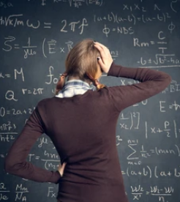
Math
abstract,
yet, embodied
External representations simplify abstract concepts and procedures, aiding in visuo-spatial understanding (Tabatabaeian et. al, 2023).
Notes:
In the intricate realm of mathematics, where concepts unfold as abstract entities, the practice of this discipline takes on a tangible and embodied form. Mathematicians actively and physically engage in the intellectual dance with numbers and patterns. How close or far they are from the chalkboard changes how they see things, giving different perspectives and ways to represent math ideas.
The choice of visual representation emerges as a key player, guiding mathematicians through the process of complex problems. These external representations simplify abstract concepts and procedures, and in doing so, fostering a profound visuo-spatial understanding that paves the way for breakthroughs in mathematical cognition.

Slide 3
Current Study
The current study leverages a video corpus to systematically explore the body's role in mathematical reasoning.
Research question
What are experts typically doing with their bodies when they are engaged in creative mathematical reasoning?

Slide 4
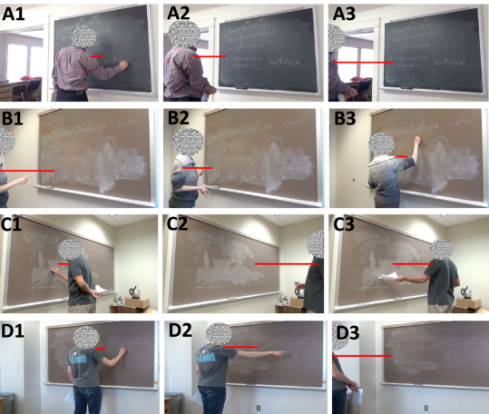
Mathematicians
move around
write
scribble
draw
sketch
elaborate
Erase
gesture toward
interpret
Marghetis et al. (2019)
Notes:
The video corpus was originally compiled by Marghetis et al. (2019) to explore mathematical reasoning within ecologically valid settings. The mathematicians conducted their work at blackboards in their personal offices.
The moment-to-moment work of mathematics is material and messy. Mathematicians write, scribble, draw, sketch. Then they elaborate, erase, gesture toward, and interpret those inscriptions.

Slide 5
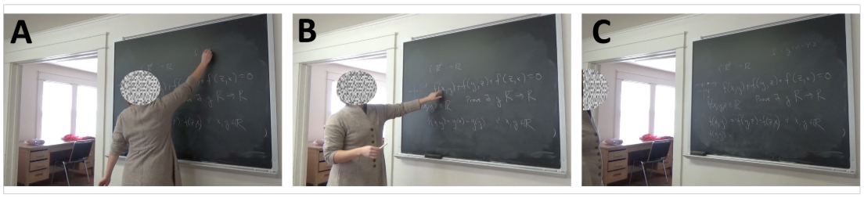
close
medium
far
Hypothesis
Mathematicians spend more time standing close to the board earlier in the session and more time farther from the board as the session continues.
Notes:
While copiously writing and gesturing, mathematicians move from within writing distance (A), to medium distance where writing is difficult but pointing is easy (B), to a far distance where they could see the entire blackboard (C). From Tabatabeian et.al, 2023.
Speceifically, we hypothesized that Mathematicians spend more time standing close to the board earlier in the session and more time farther from the board as the session continues.
As mathematicians engage in prolonged problem-solving sessions, there is a tendency for them to transition from close proximity to the chalkboard to greater distances, suggesting a dynamic spatial pattern in the exploration and development of mathematical ideas over time.

Slide 6
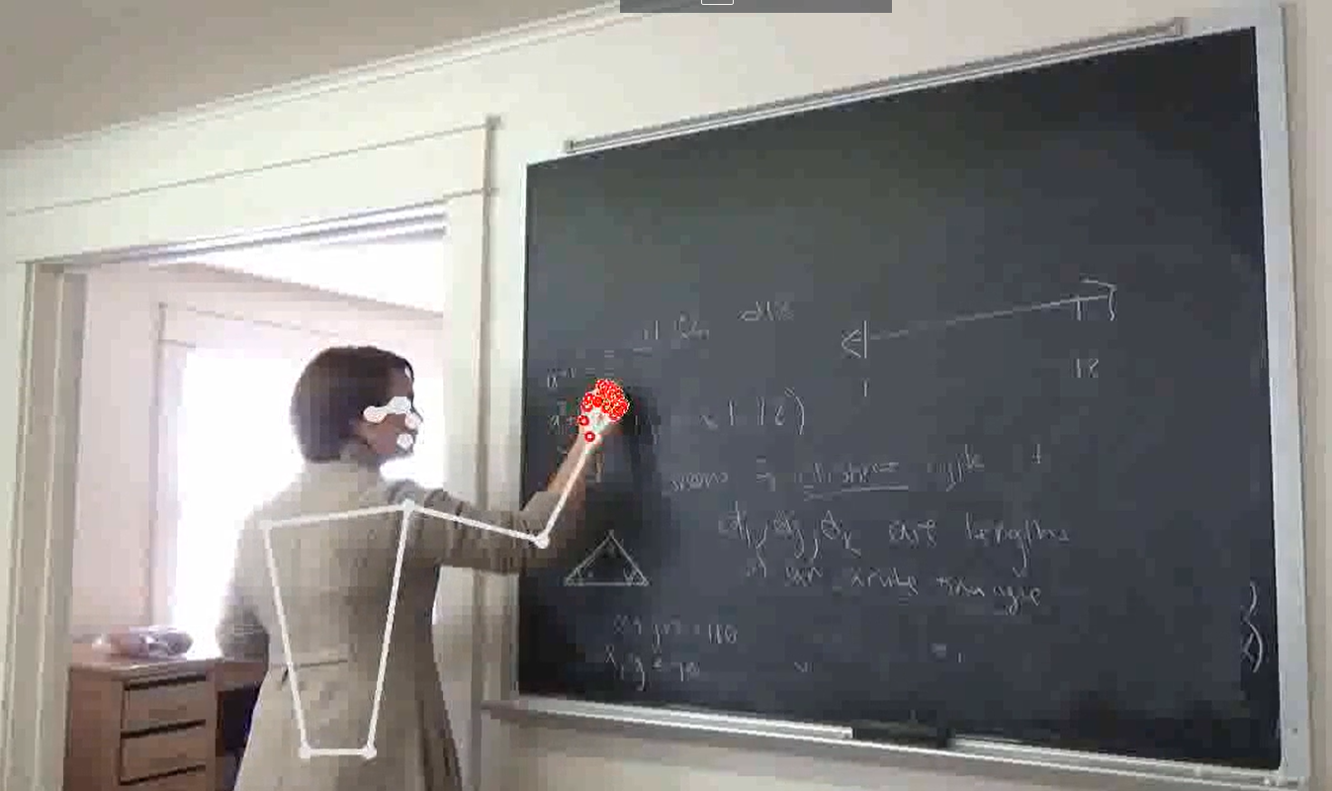
Mediapipe Pose Landmarker used to track different body parts in hertz.
30 hertz = 1 sec
Notes:
In the current analysis, machine learning techniques, Mediapipe Pose Landmarker in python, provided spatiotemporal results in three dimensions (x, y, and z) for various body parts, like shoulders, elbows, wrists and fingures. This Mediapipe tracks the body parts 30 times a second. I used these results to analyze mathematician’s specific body part’s distance from the chalkboard throughout the course of dealing and solving the math problems.

Slide 7
Results
Notes:
I have not conducted any analysis given the immense scale of the dataset, and here I’ll focus on visualizations. It’s an on-going project that I with my advisor are currently working on. It’s solely based on the descriptive statistics.

Slide 8
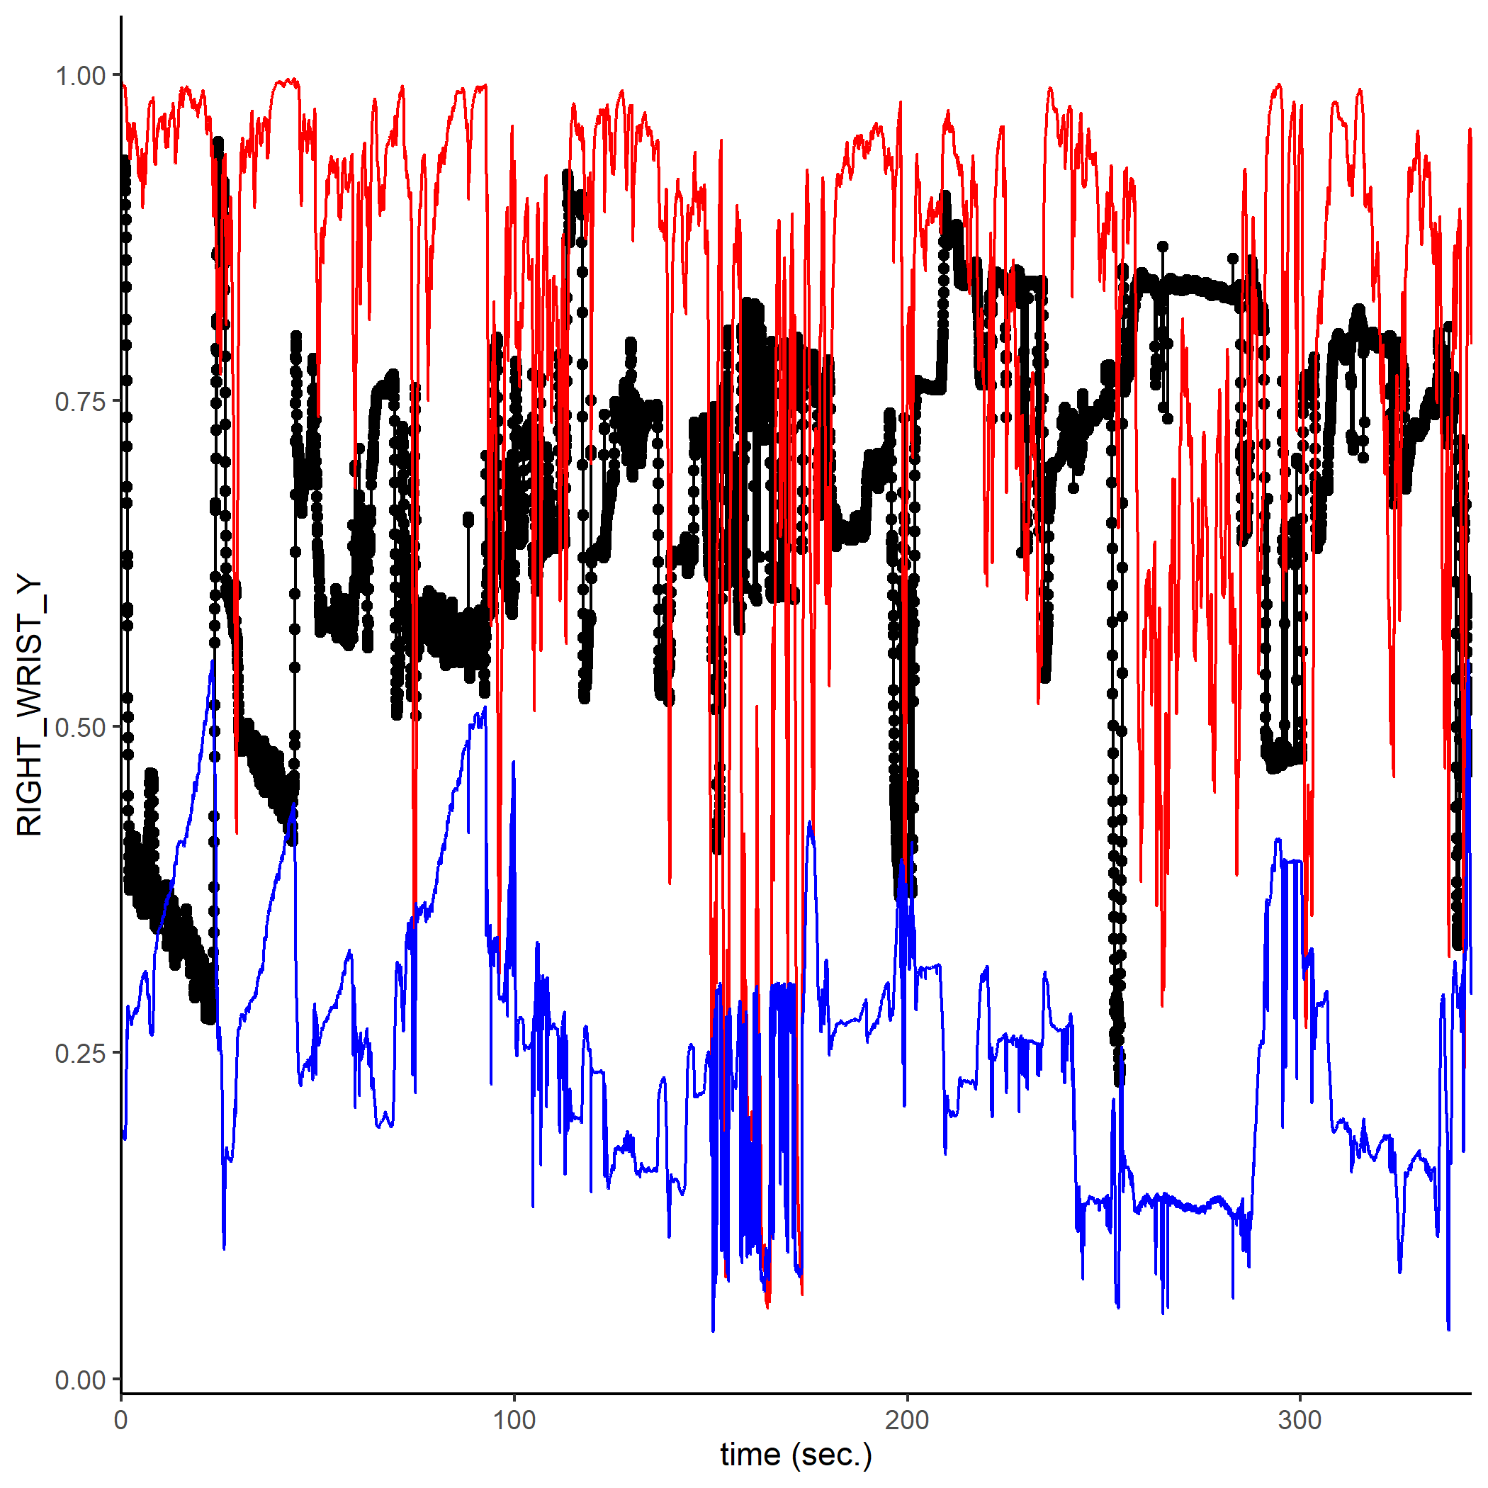
Right Wrist
Notes:
Given the complex nature of tracking different body parts, the first thing that we need to look at, is how confident the machine is in tracking the mathematician’s body. Here, for example, for right wrist, the red line shows the visibility of the wrist and we see that it’s too messy and way below 1 over the course of the session and is not reliable.

Slide 9
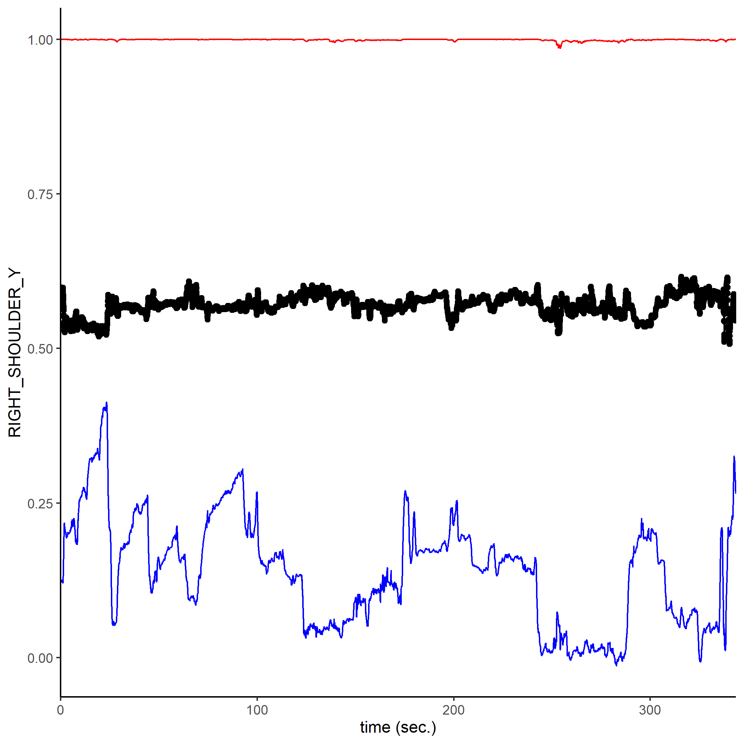
Right Shoulder
Notes:
But if we look at the right shoulder, we see that the machine algorithm is pretty confident in tracking its motions throughout the session. Therefore, I used the right shoulder for distance visualization.

Slide 10
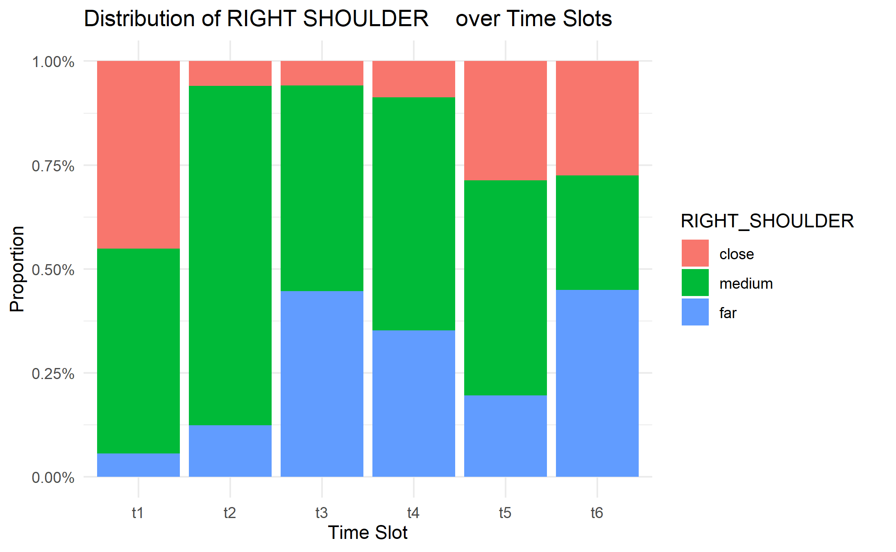
Right Shoulder Distance
Notes:
Building upon the recent study by Tabatabaeian et al. (2023), I divided the time period into six timeslots. I then classified numerical distances into three categories: close, medium, and far. As we can see, it appears that mathematicians tend to spend a greater portion of their time in close proximity to the board during the initial stages of the session and more time farther from the board as the session continues. However, it is important to note that we have not yet reached conclusive results.

Slide 11
Discussion
Mathematicians actively engage their bodies in real-world mathematical activities (Marghetis et. al, 2019).
Constant interaction with the environment through inscriptions, gestures, speech, and gaze.
Creation of inscriptions is front-loaded, concentrated at the beginning of the session.
Mathematicians spend more time in close proximity to the board initially and gradually move farther away.
Mathematicians frequently move around the room, adjusting distances from the board.
Adjusting distance actively manipulates visual information, potentially enhancing the discovery of unexpected connections.
Mathematicians' movements are not aimless; they actively manipulate visual information, seeking hidden connections while away from the board.
Notes:
So, Mathematicians immerse themselves in real-world mathematical activities, actively utilizing their bodies for constant interaction with the environment through inscriptions, gestures, speech, and gaze. The creation of inscriptions is concentrated at the beginning of the session, with mathematicians spending more time in close proximity to the board initially and gradually moving farther away. Their frequent movement around the room involves adjusting distances from the board, an active manipulation of visual information aimed at potentially enhancing the discovery of unexpected connections. Far from aimless, mathematicians' movements are purposeful as they seek hidden connections even while away from the board.

Slide 12
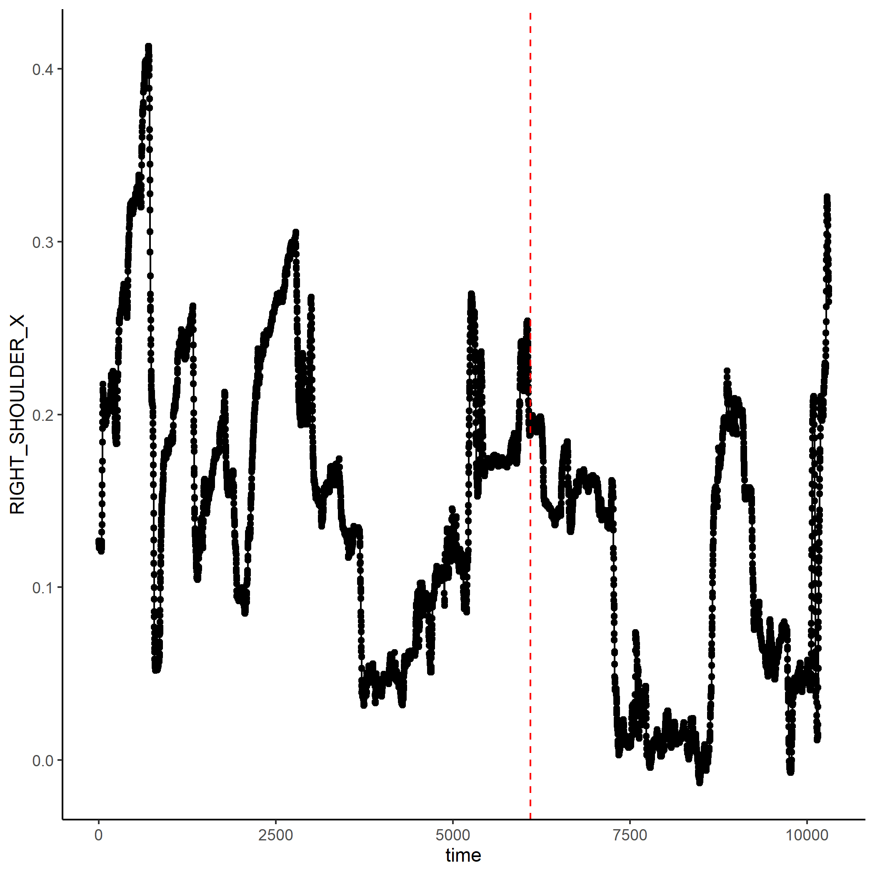
Insight moment

